Slide 1



Header
Playlist
Credits
Group names
Basic Song Search
Browse / Search Results
GitHub url
Title
Type here
Title
Artist
Year
Genre
Popularity
Artist
Pick one
Add
Genre
Pick one
Clear
Filter
Footer

Slide 2
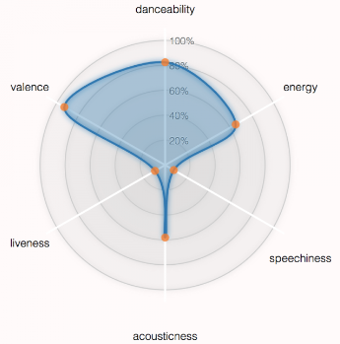
Header
Close View
Credits
Song Information
Radar Chart
title, artist name, artist type, genre, year, duration
Analysis data:
bpm,
energy,
danceability,
liveness,
valence,
acousticness,
speechiness,
popularity
Footer

Slide 3
Header
Close View
Credits
Playlist Details
# songs, popularity ranking
Clear Playlist
Title
Artist
Year
Genre
Popularity
Remove
Footer

